Slide 1
Upgrade to First Class with Calculation Groups for Power BI
Jason Romans

Slide 2


Jason Romans
The Dax Shepherd
Senior BI Engineer
Builder of Models
Lives in Nashville, Tennessee, United States
Started as SQL Server DBA
Transitioned to the Microsoft BI Stack
Work on everything from SQL Server Integration Services, SQL Server Database, Analysis Services, and Power BI
Favorite Data Model

Slide 3

Speaker Feedback
https://sqlb.it/?12595

Slide 4




Flight School
Standing on the Shoulders of Giants
Flight Instructors

Slide 5
Our Journey
1. Why Calculation Groups
2. How to Create
3. Calculation Items
4. Multiple Calculation Groups
5. Conclusion

Slide 6
Our Journey
1. Why Calculation Groups
2. How to Create
3. Calculation Items
4. Multiple Calculation Groups
5. Conclusion

Slide 7

It starts with one measure…
Sales Amount
We need to create a version for each variation
Sales Amount MTD – Month to Date
Sales Amount QTD – Quarter to Date
Sales Amount YTD – Year to Date
Sales Amount SPLY – Same Period Last Year

Slide 8
Can you do the same for this measure?
Total Cost
Total Cost QTD
Total Cost MTD
Total Cost YTD
Total Cost SPLY

Slide 9
And Now These…
Margin
Margin %
Volume
EBITDA

Slide 10
Difficult to Manage Variations
For each measure
At least 4 variations
My First Model

Slide 11
Difficult to Switch Between
Example:
Place variations on a slicer
Current, MTD, YTD

Slide 12
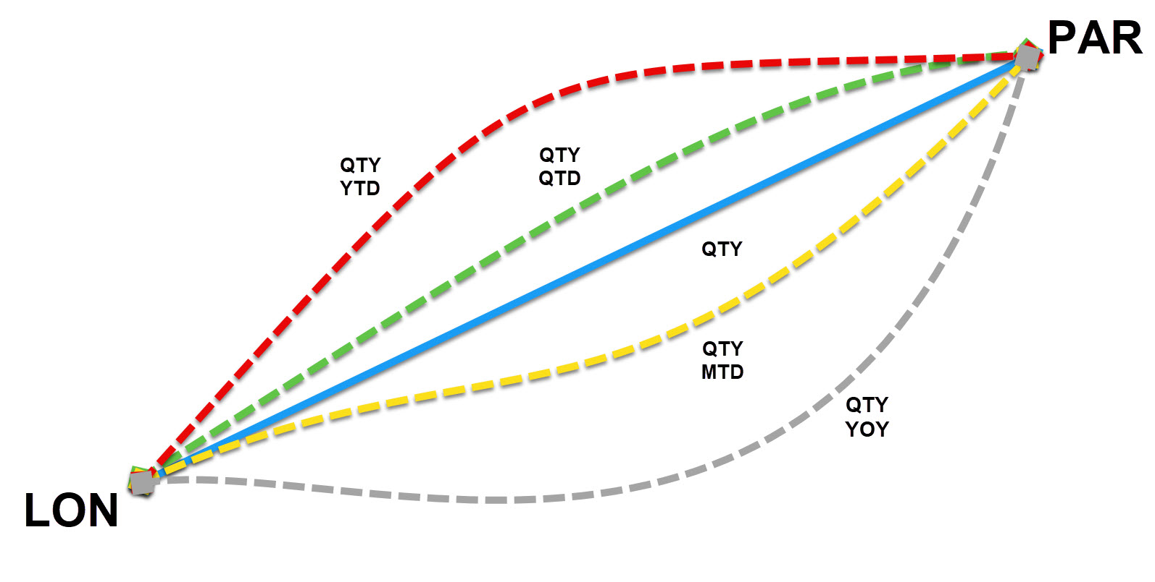
Multiple Variations

Slide 13
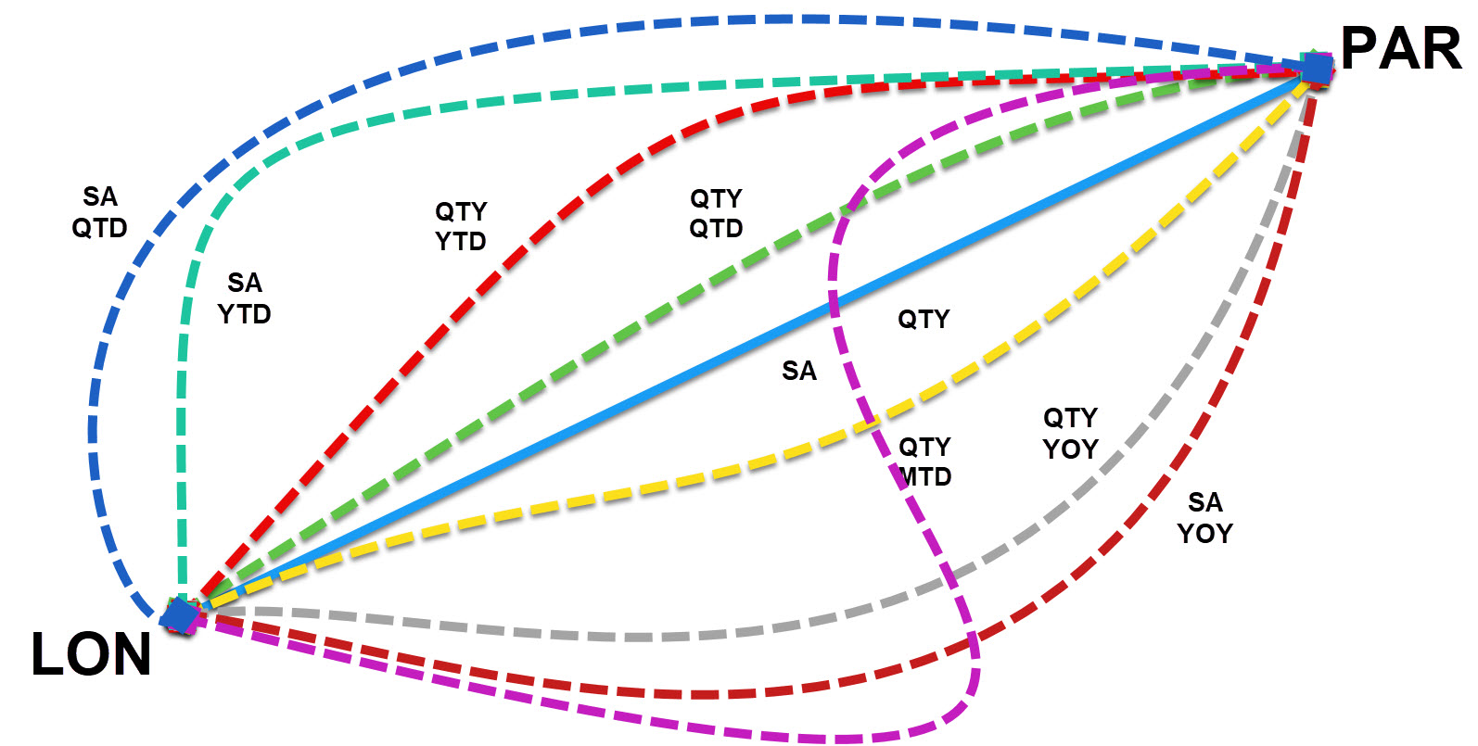
Multiple Variations

Slide 14
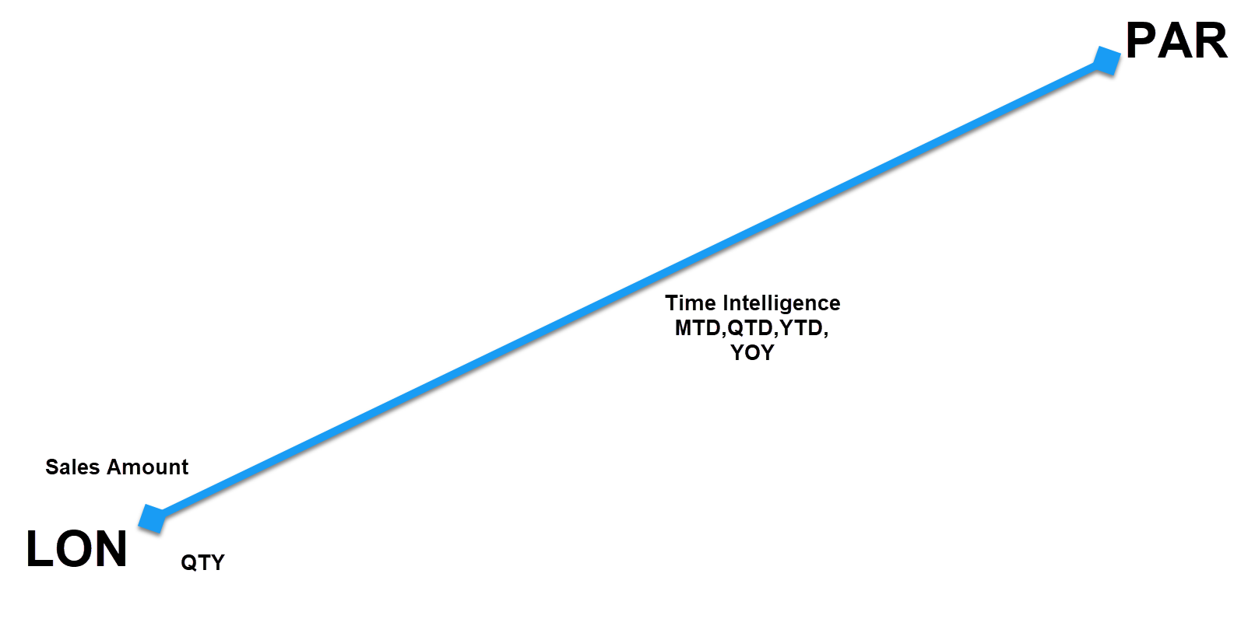


Simplified

Slide 15


We need a better way

Slide 16
The Pattern is the Same
Sales Amount YTD
Total Cost YTD
Margin YTD

Slide 17
It is the measure that changes
Sales Amount YTD
Total Cost YTD
Margin YTD

Slide 18
Placeholder for the Measure
Measure_Variable??
Sales Amount YTD
Total Cost YTD
Margin YTD

Slide 19
Rest of the Code is the Same
CALCULATE ( Measure_Variable, DATESYTD ('Date'[Date]))
Sales Amount YTD
Total Cost YTD
Margin YTD

Slide 20
Rest of the Code is the Same
CALCULATE ( Measure_Variable, DATESYTD ('Date'[Date]))
Sales Amount YTD
Total Cost YTD
Margin YTD

Slide 21
Only Need to Write Pattern One Time
YTD =
CALCULATE ( Measure_Variable, DATESYTD ( 'Date'[Date] ) )

Slide 22
Launch Calculation Groups on Alert 5
This is what Calculation Groups were designed for
Just need a way to handle the Measure_Variable

Slide 23
Introducing
SELECTEDMEASURE()
SELECTEDMEASURE()
YTD =
CALCULATE ( Measure_Variable, DATESYTD ( 'Date'[Date] ) )

Slide 24
SELECTEDMEASURE()
YTD =
CALCULATE ( SELECTEDMEASURE(), DATESYTD ( 'Date'[Date] ) )

Slide 25
Measure Selected
[Sales Amount]
YTD =
CALCULATE ( SELECTEDMEASURE(), DATESYTD ( 'Date'[Date] ) )

Slide 26
Replaces Measure in DAX Code
YTD =
CALCULATE ( [Sales Amount], DATESYTD ( 'Date'[Date] ) )

Slide 27
We have a method to handle different measures
What are some of the benefits we expect to achieve

Slide 28
Benefits
Fewer measures to maintain
Reuse already established Measures
Use on multiple measures
Control formatting

Slide 29
What Does This Look Like

Slide 30
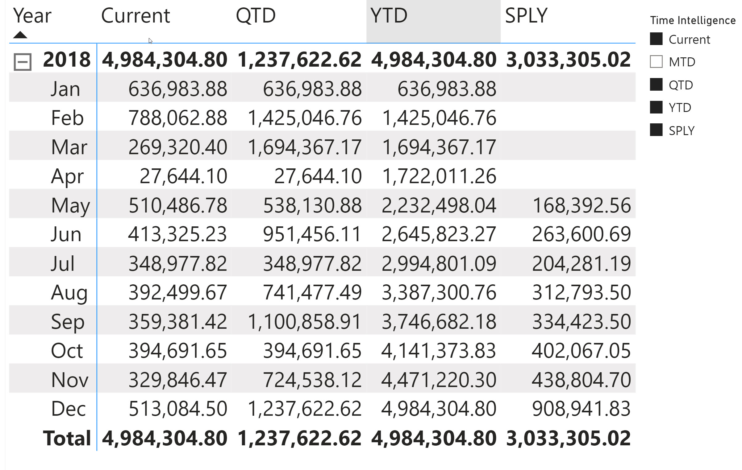
Time Intelligence – 1 Measure
Sales Amount

Slide 31
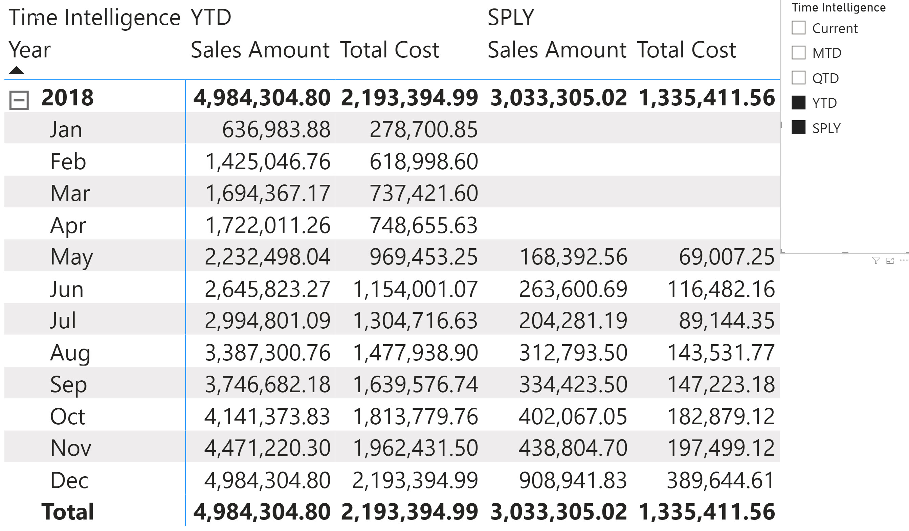
Time Intelligence – 2 Measures
Sales Amount & Total Cost

Slide 32
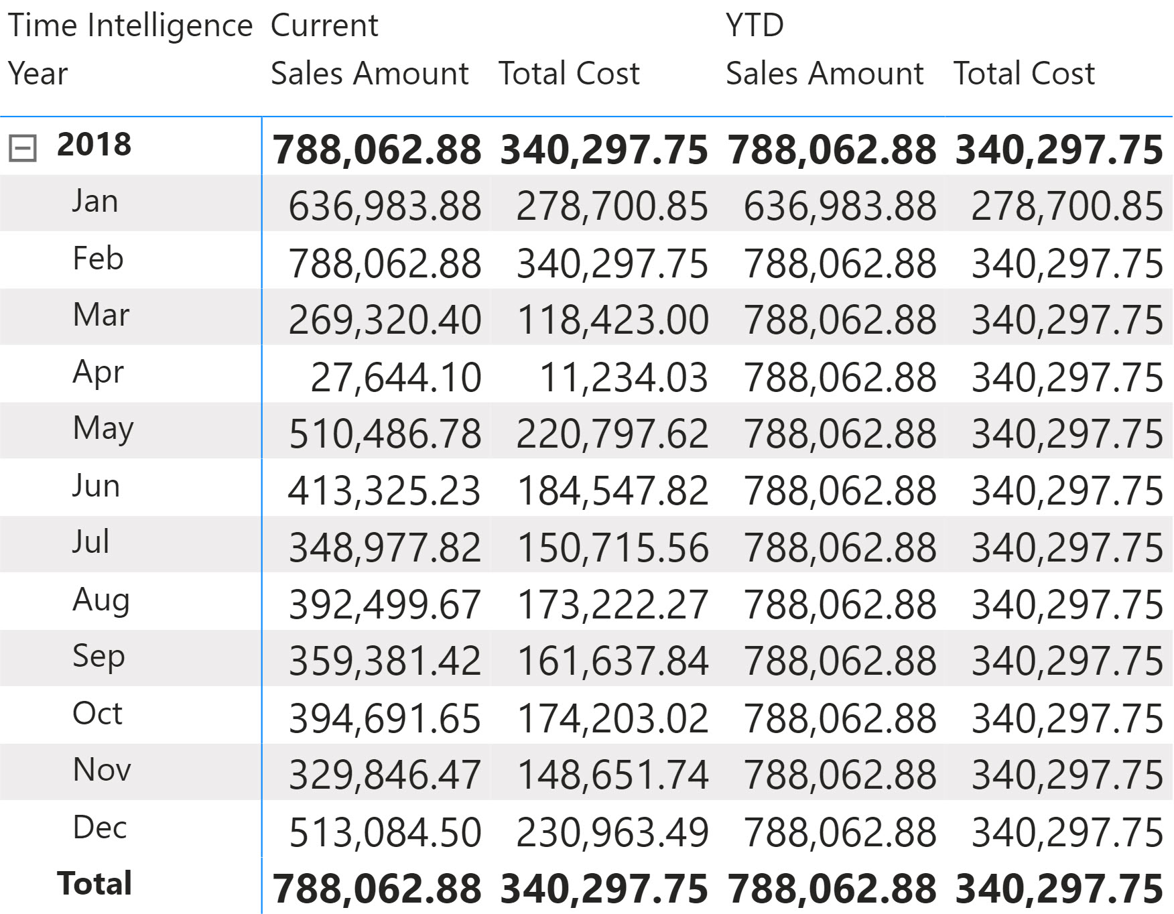
2 Measures with
Time Intelligence and Statistics (MAX)
Both MAX
No Time Intelligence
YTD

Slide 33
Are Calculation Groups New?
Since about 2019
Required the use of Tabular Editor
Power BI Desktop October 2023 Release (Preview)
Will increase the adoption rate

Slide 34
Our Journey
1. Why Calculation Groups
2. How to Create
3. Calculation Items
4. Multiple Calculation Groups
5. Conclusion

Slide 35
Two Ways
Tabular Editor
Up till the October 2023 release - only way
Power BI Desktop (Preview)
October 2023 release or newer

Slide 36
Creating in Power BI Desktop

Slide 37
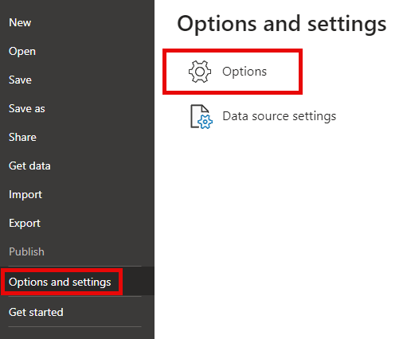
Power BI Desktop Enable Preview - Options

Slide 38
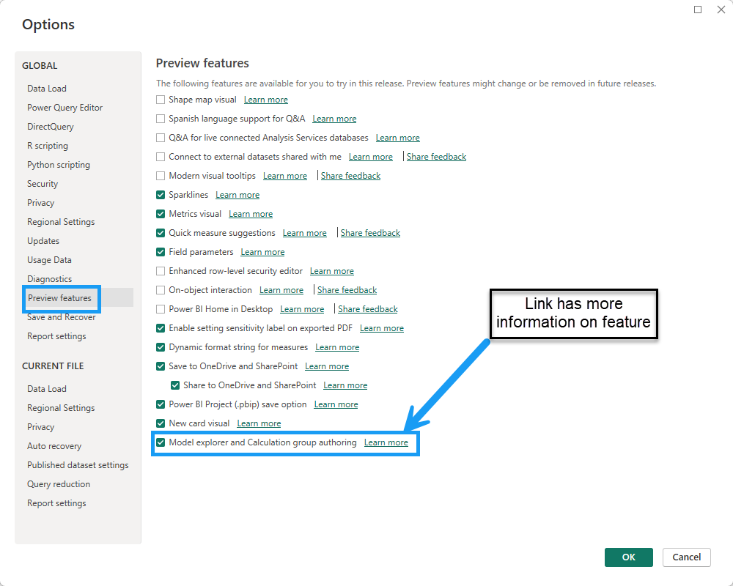
Power BI Desktop Preview Features

Slide 39
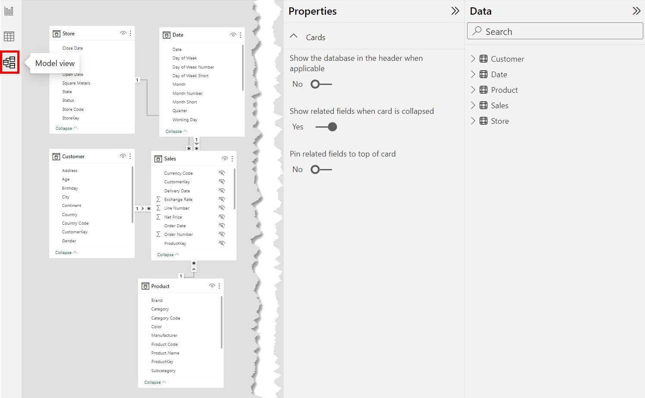
Power BI – Model Explorer Not Enabled

Slide 40
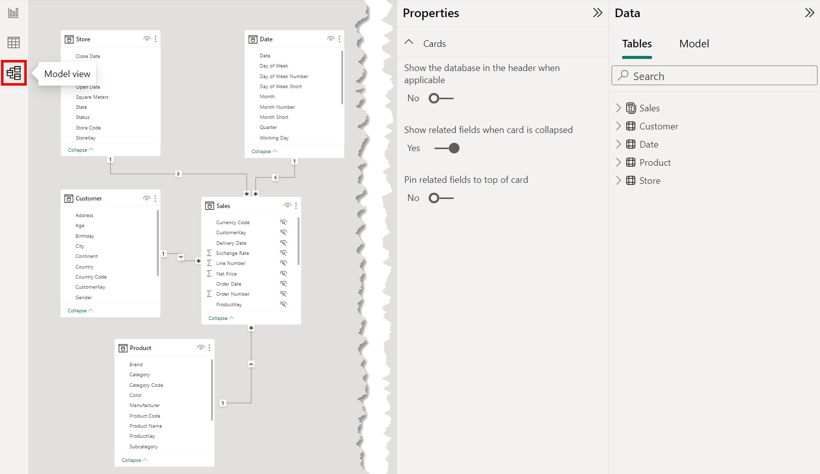
Power BI – Model View - Tables

Slide 41
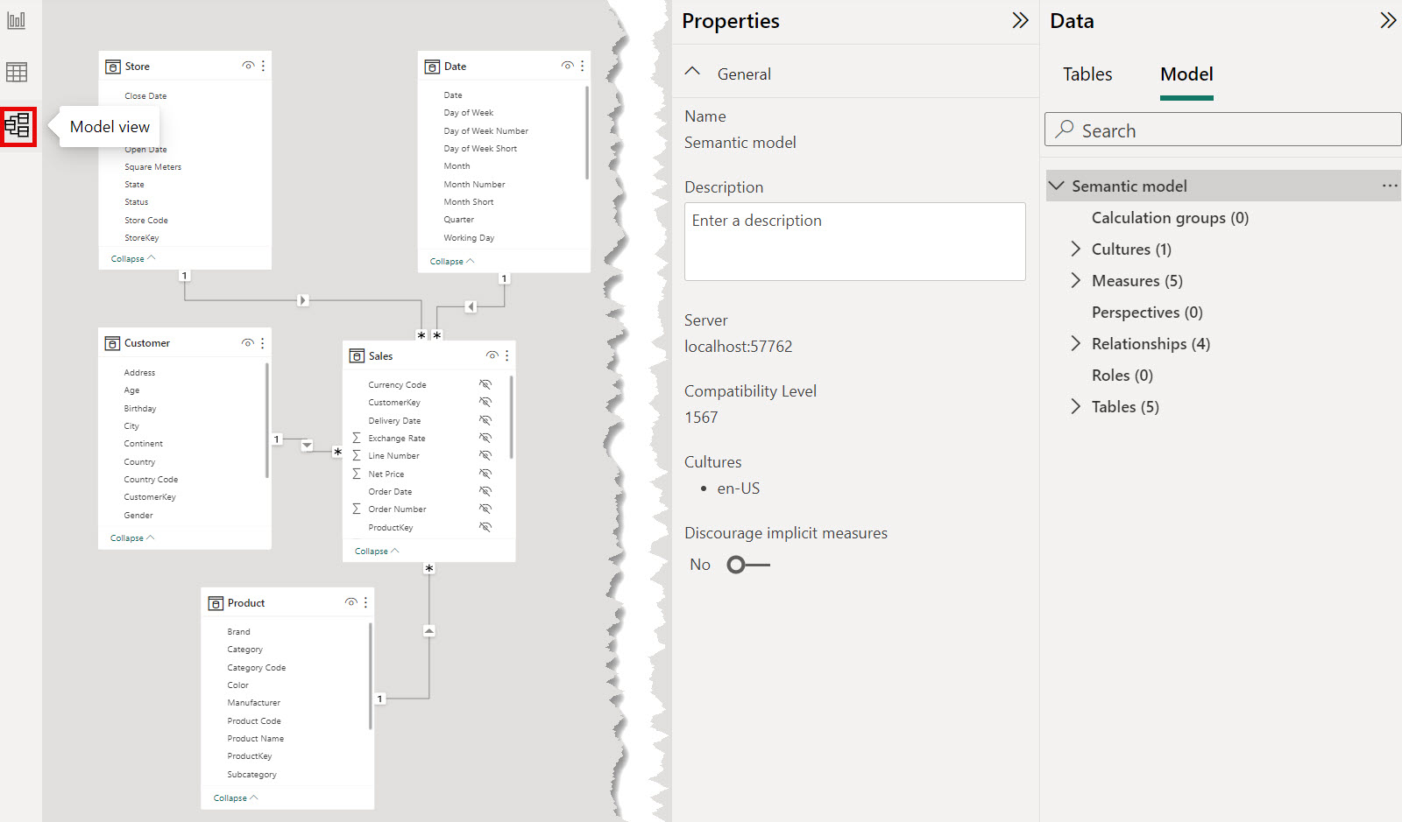
Power BI – Model View – Model Explorer

Slide 42
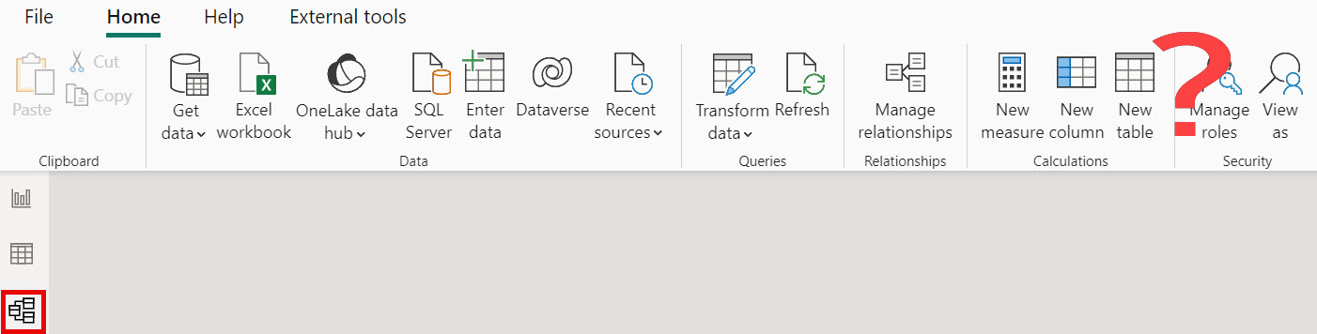
Model Explorer Off – No Calculation Group

Slide 43
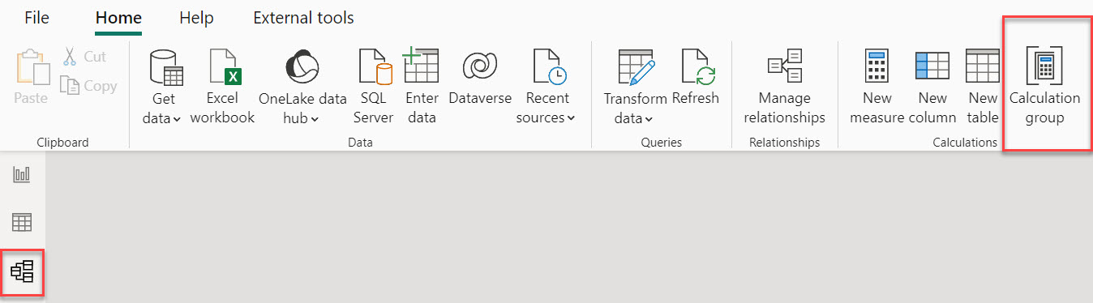
Click Calculation Group

Slide 44
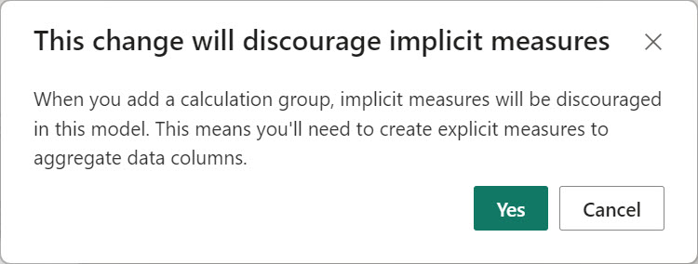
Discourage Implicit Measures
A little bit to unpack here

Slide 45
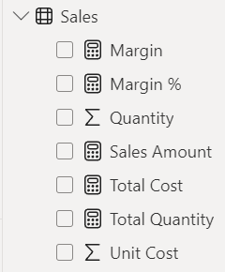
What is an Implicit Measure?

Slide 46
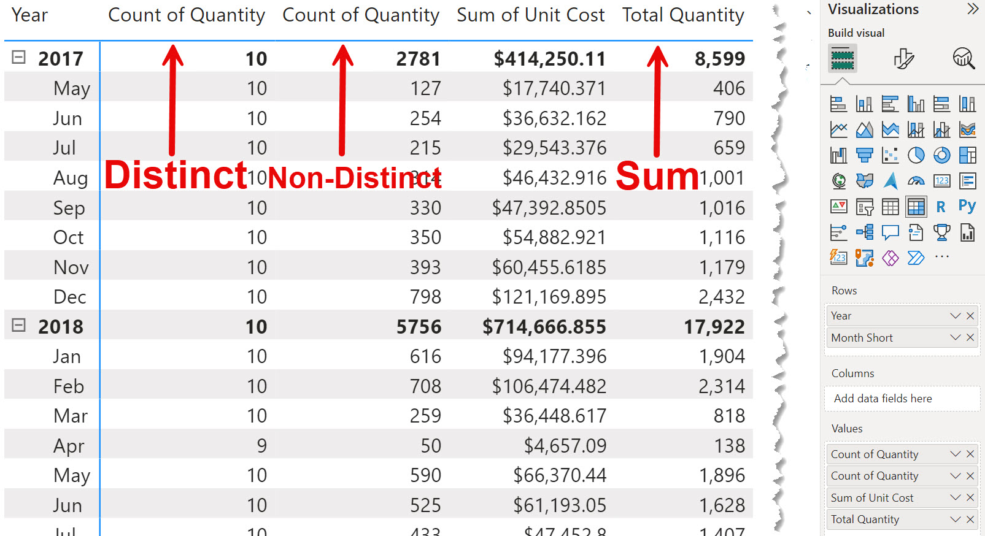
Implicit Measure Example
Measure with formatting

Slide 47
Implicit Versus Explicit Measures
Implicit
Drag the value column to visual and it automatically aggregates it
It is creating the calculation for you
Explicit
Control formatting
Only expose measures to developers
Can change the logic of the measure – Like a SQL View

Slide 48
“Discourage” Implicit Measures

Slide 49
“Discourage” Implicit Measures

Slide 50
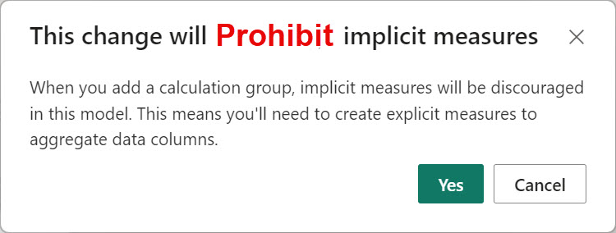
Discourage Implicit Measures

Slide 51

Discourage

Slide 52
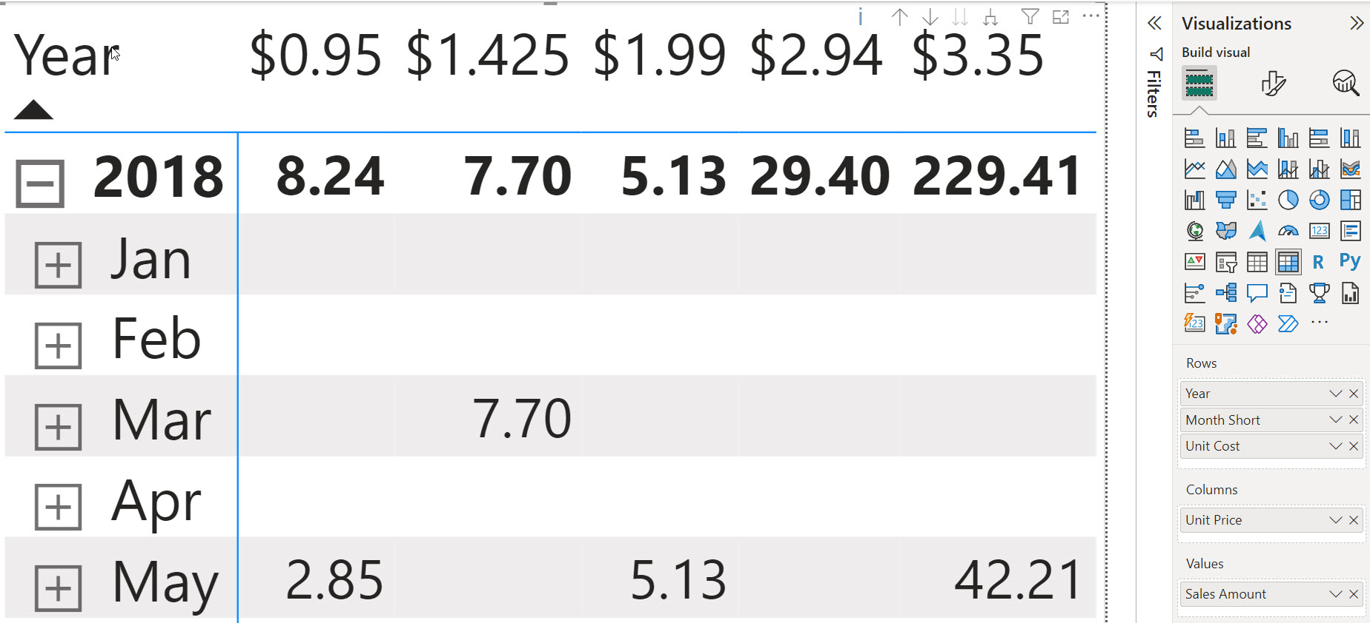
Discourage Implicit Measures Behavior
Cannot put the fields on Values. Must put on Columns, Rows, etc.

Slide 53
Return to Creating Calculation Group

Slide 54
We accept this change

Slide 55
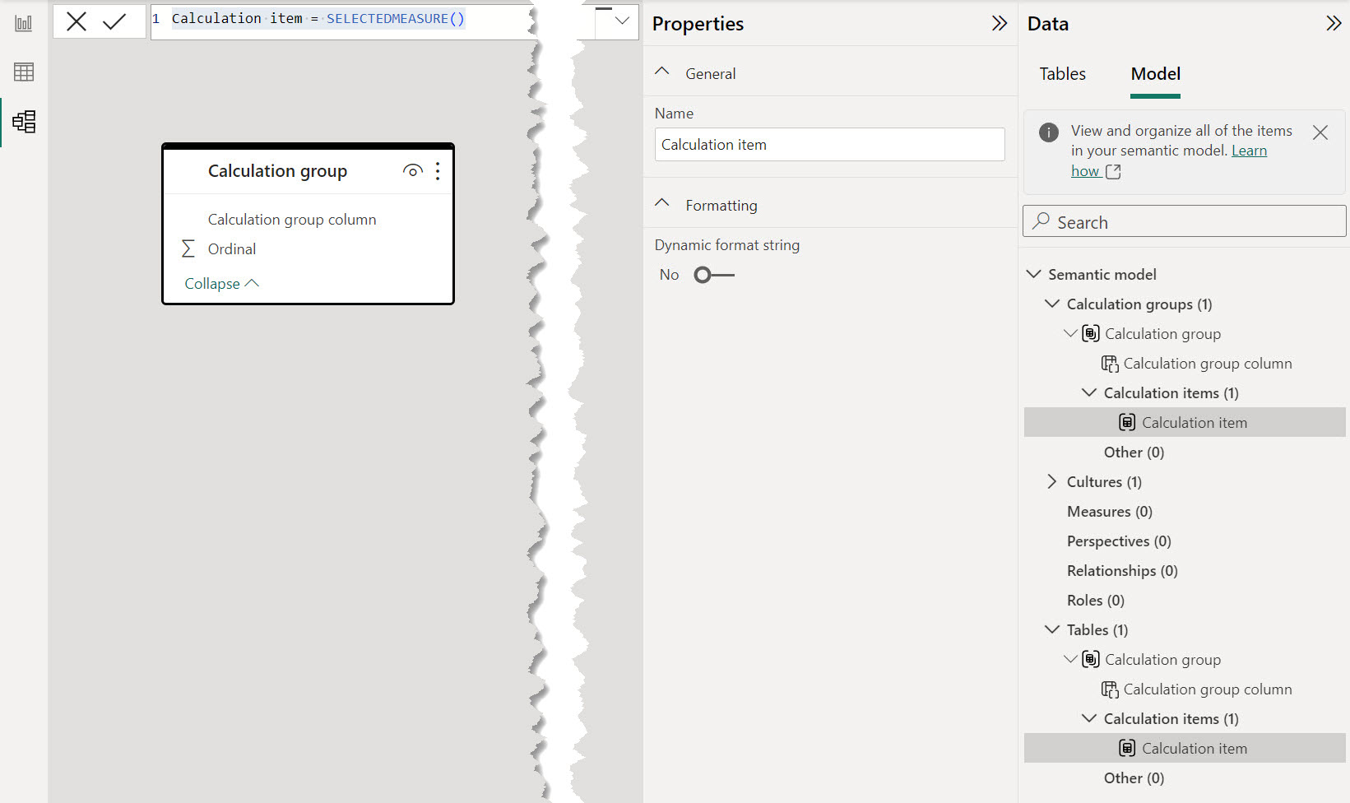
New Calculation Group View

Slide 56
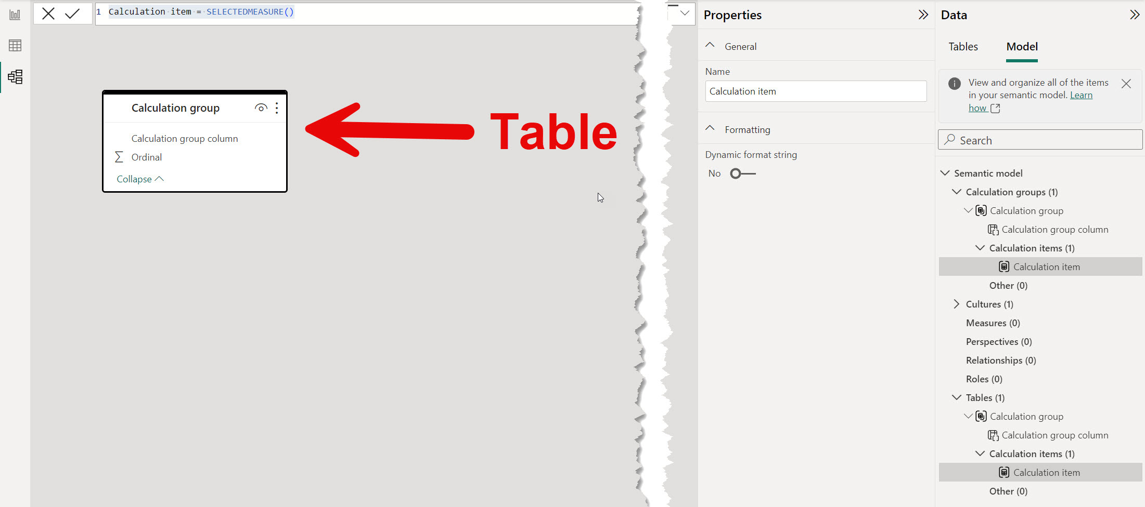
Calculation Group is Just a table

Slide 57
Table has a column for Calculation Items
Table has a column for Calculation Items
Calculation Item is just a value in the column

Slide 58
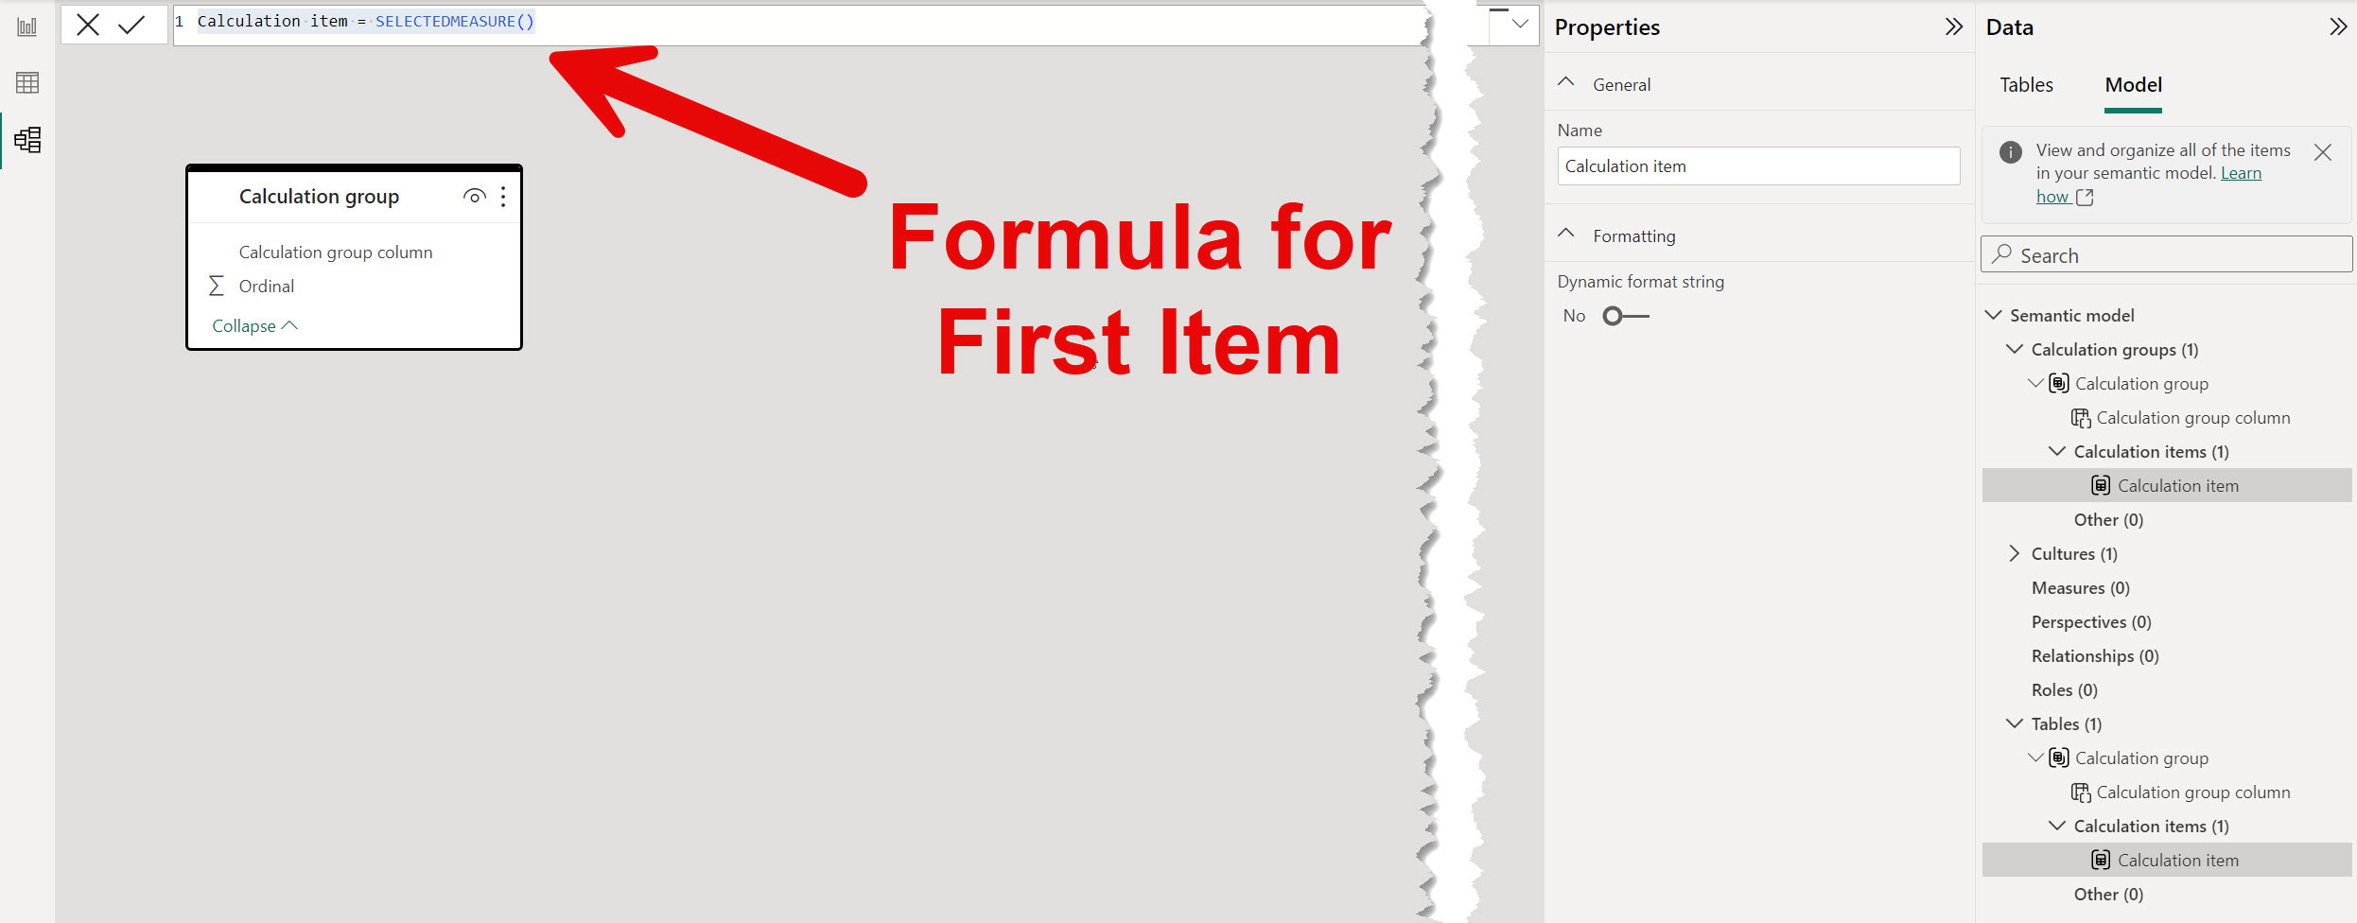
Formula for new Calculation Item

Slide 59
Simplest Calculation Item
Value or Current =
SELECTEDMEASURE()

Slide 60
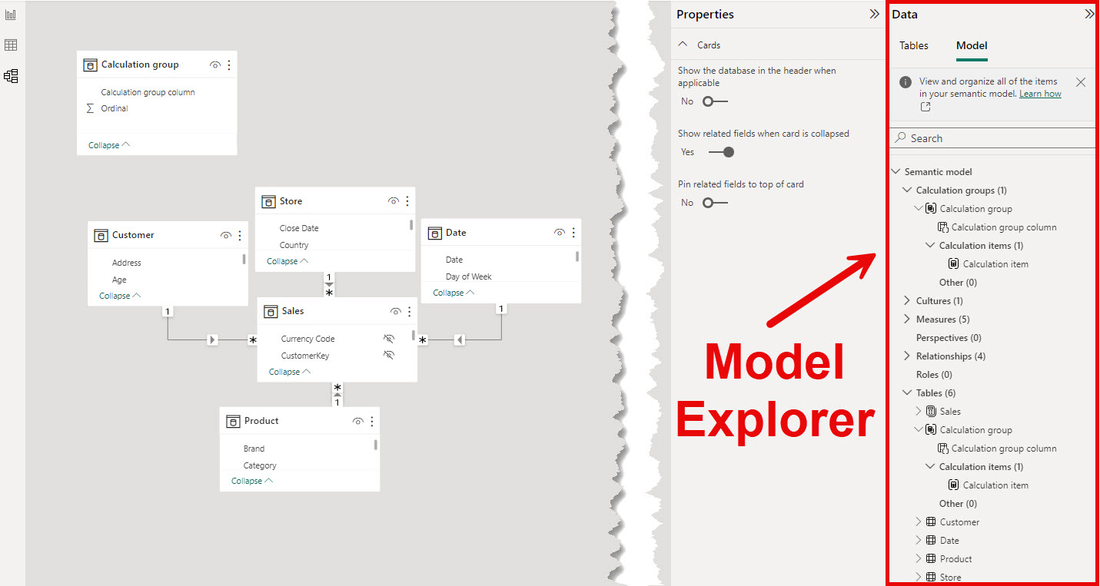
Model Explorer Settings

Slide 61
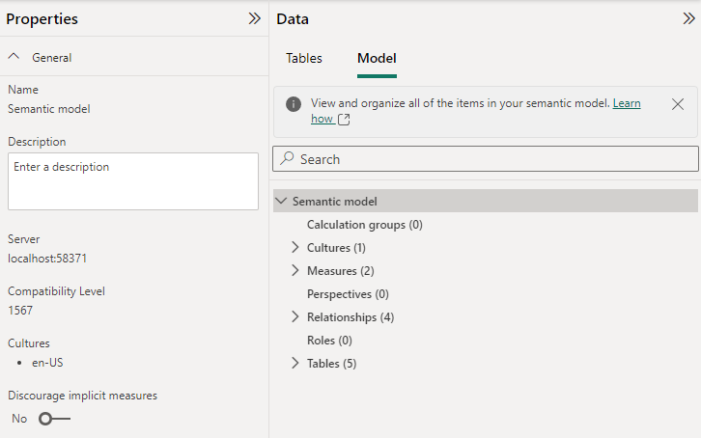
Model Properties

Slide 62
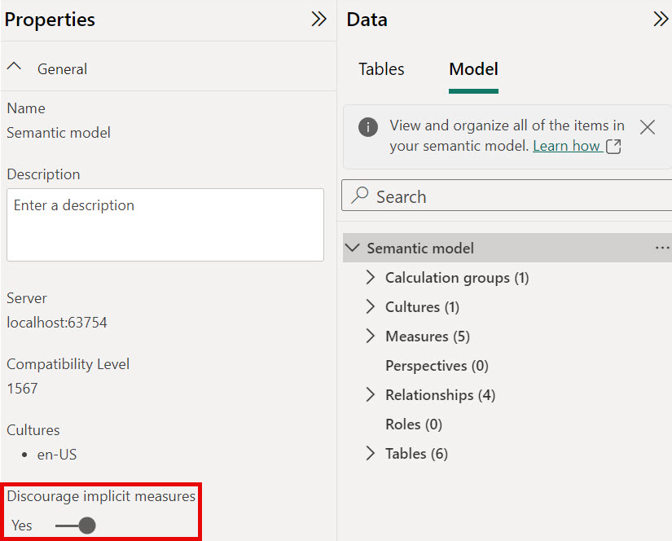
Discourage Implicit Measures Setting
We can flip this switch back to No if we delete all Calculation Groups

Slide 63
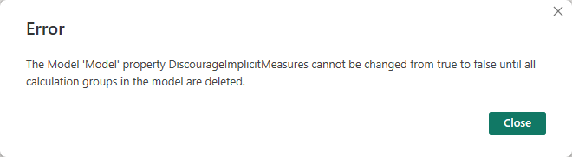
Discourage Implicit Measures Error

Slide 64
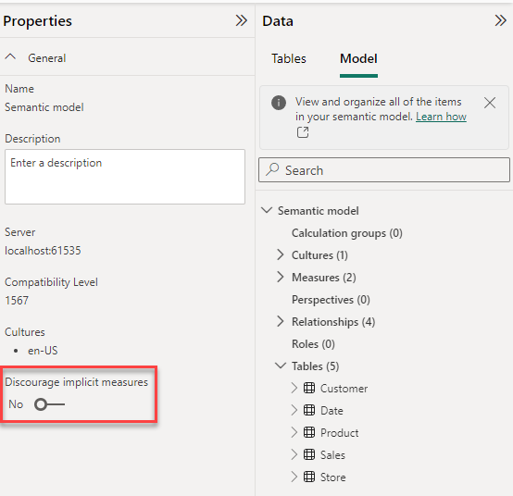
Can Be Reenabled

Slide 65
Power BI Desktop Demo

Slide 66
Creating in Tabular Editor

Slide 67
Why Tabular Editor?
Speed up Development
Access Features not in Power BI Desktop
What’s in your Toolbelt?

Slide 68
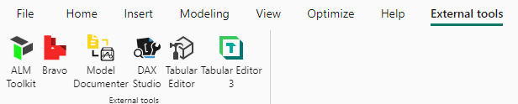
Full Install – Will appear in External Tools Tab

Slide 69
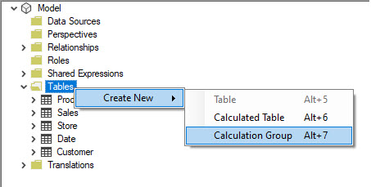
New Calculation Group – Under Tables

Slide 70
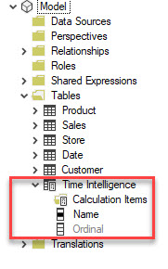
New Calculation Group

Slide 71
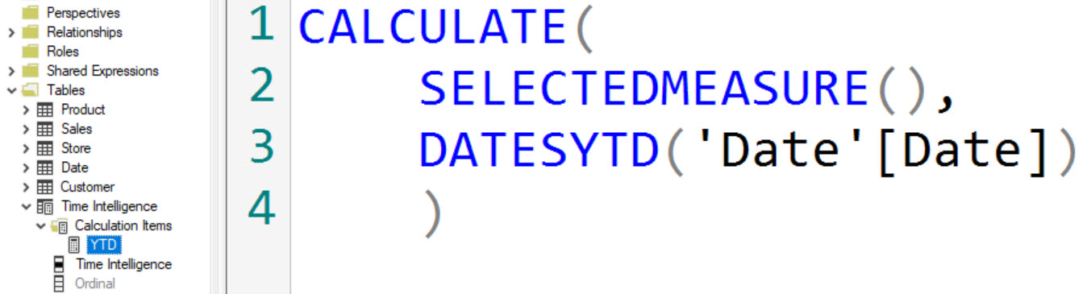
Calculation Item

Slide 72
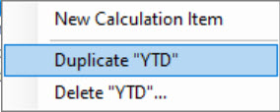
Tabular Editor 2 Tricks - Duplicate

Slide 73
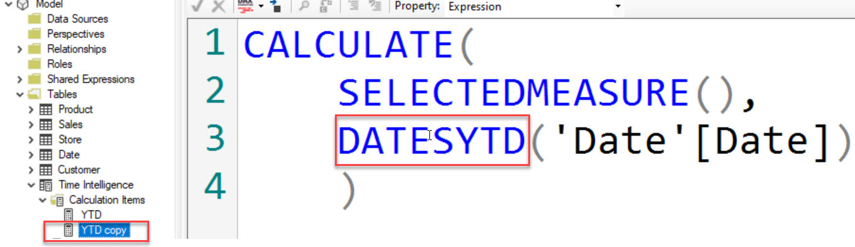
TE 2: Duplicate – Make Changes

Slide 74
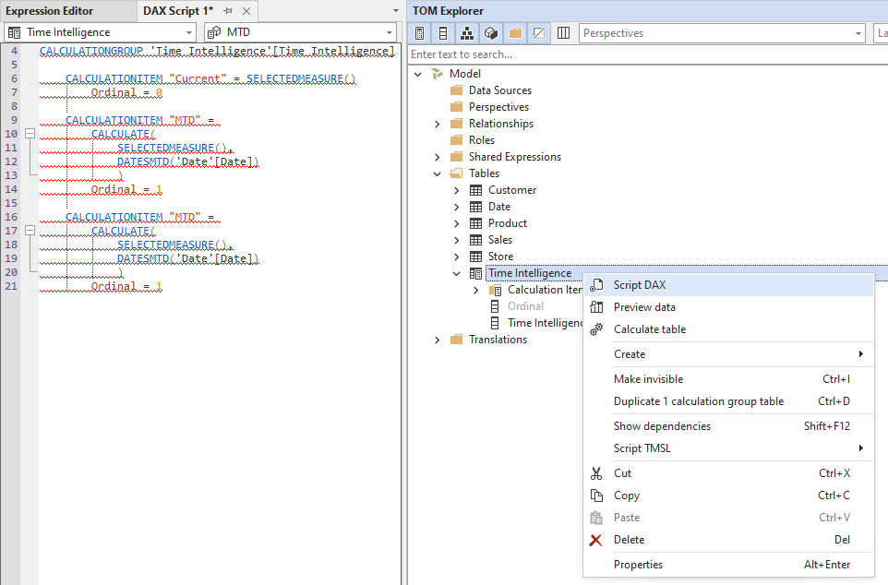
Tabular Editor 3 – Script DAX

Slide 75
Power BI - Refresh is Required

Slide 76
Our Journey
1. Why Calculation Groups
2. How to Create
3. Calculation Items
4. Multiple Calculation Groups
5. Conclusion

Slide 77
Ordinal

Slide 78
Who’s Out of Order
Determines the order that Calculation Items are displayed
Hidden column
Automatically Orders Calculation Items by this column

Slide 79
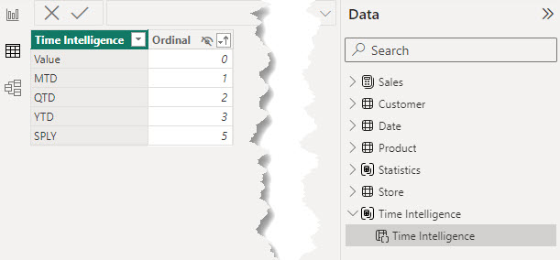
Ordinal – Just a hidden column in the table

Slide 80
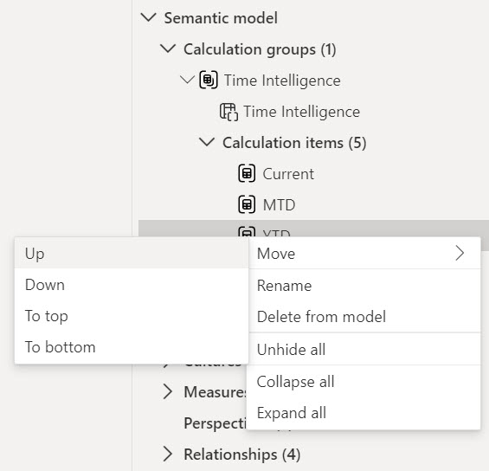
Power BI Change Ordinal – Right Click

Slide 81
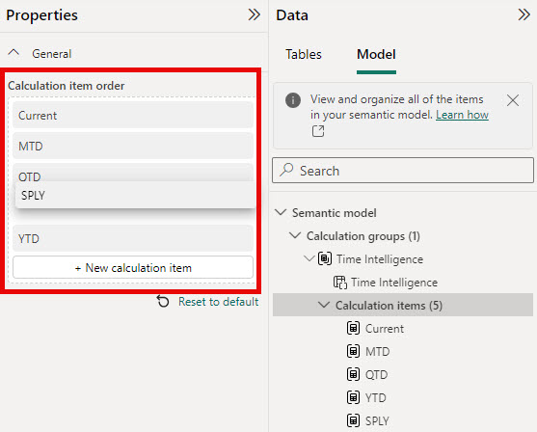
Power BI Change Ordinal – Drag and Drop

Slide 82
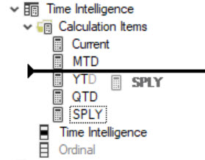
Tabular Editor – Drag and Drop

Slide 83
Custom Format Strings

Slide 84
Custom Format Strings
If we don’t want the format of the original measure

Slide 85
Example Custom Format Strings
Example Measure is [Sales Amount]
CY = SELECTEDMEASURE()
PY = SELECTEDMEASURE() for SPLY
YOY = CY – PY
YOY % = DIVIDE(CY-PY, PY)
YOY % Format String = "0.00%"

Slide 86
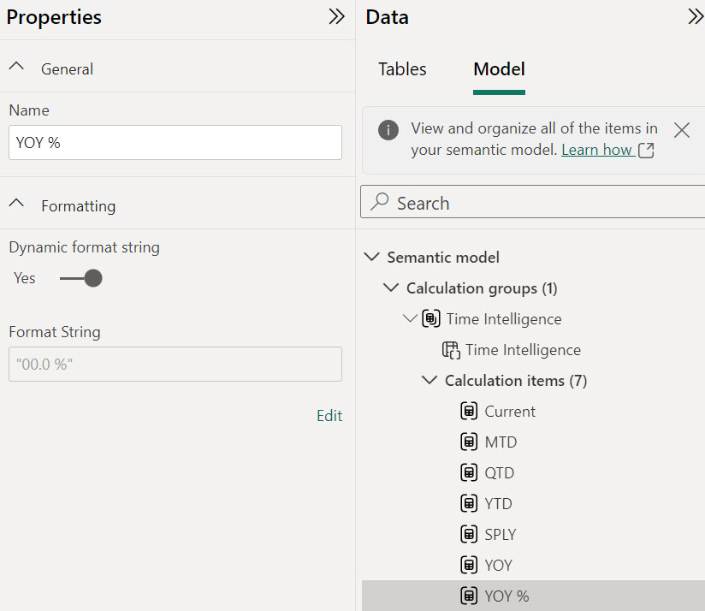
Power BI: Format Strings

Slide 87
Dynamic Format Strings
DAX expression to determine the format string
SELECTEDMEASUREFORMATSTRING()
Returns measure format string
Example Use
Only on these measures append this Unit of Measure

Slide 88
ISSELECTEDMEASURE ()

Slide 89
ISSELECTEDMEASURE ()
IF (
NOT ISSELECTEDMEASURE ([Margin %]),
DO THIS,
Otherwise
Maybe SELECTEDMEASURE ()
)

Slide 90
ISSELECTEDMEASURE ()
Average = IF ( NOT ISSELECTEDMEASURE ( [Margin %] ), AVERAGEX ( VALUES ( 'Date'[Year Month Number] ), SELECTEDMEASURE () ), SELECTEDMEASURE() )

Slide 91
Our Journey
1. Why Calculation Groups
2. How to Create
3. Calculation Items
4. Multiple Calculation Groups
5. Conclusion

Slide 92
The Captain Has Turned on the Fasten Seat Belt Light

Slide 93
How to Handle Precedence

Slide 94
Precedence
Which Calculation Group gets applied first?

Slide 95
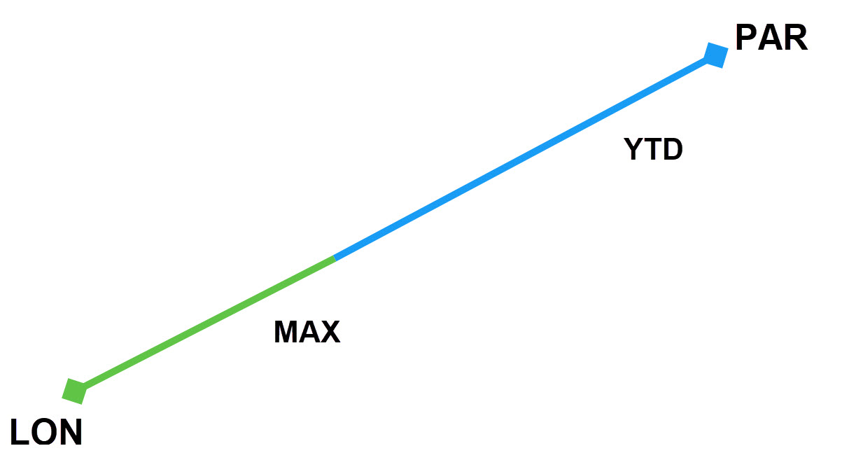
Precedence

Slide 96
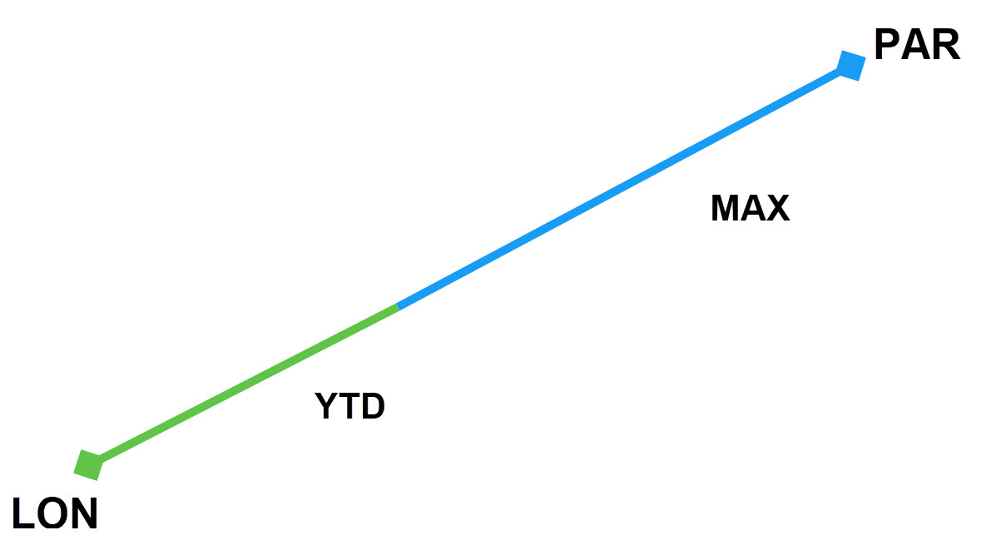
Precedence

Slide 97
Priority
Higher number has priority
Set at group level
Not at individual items

Slide 98
Precedence
Don’t let this prevent you from trying Calculation Groups

Slide 99
Stats (MAX) with higher precedence
YTD = CALCULATE ( SELECTEDMEASURE (), DATESYTD ( 'Date'[Date] ) ) –- Precedence 10
MAX = MAXX ( VALUES ( 'Date'[Year Month] ), SELECTEDMEASURE () ) – Precedence 20

Slide 100
YTD = CALCULATE ( SELECTEDMEASURE (), DATESYTD ( 'Date'[Date] ) ) –- Precedence 10
MAX = MAXX ( VALUES ( 'Date'[Year Month] ), SELECTEDMEASURE () ) – Precedence 20

Slide 101
MAXX ( VALUES ( 'Date'[Year Month] ), CALCULATE ( SELECTEDMEASURE (), DATESYTD ( 'Date'[Date] )
)

Slide 102
Not the result we were looking for…
MAXX ( VALUES ( 'Date'[Year Month] ), CALCULATE ( [Sales Amount], DATESYTD ( 'Date'[Date] )
)

Slide 103
Take two
YTD = CALCULATE ( SELECTEDMEASURE (), DATESYTD ( 'Date'[Date] ) ) –- Precedence 20
MAX = MAXX ( VALUES ( 'Date'[Year Month] ), SELECTEDMEASURE () ) – Precedence 10

Slide 104
Time Intelligence with higher precedence
YTD = CALCULATE ( SELECTEDMEASURE (), DATESYTD ( 'Date'[Date] ) ) –- Precedence 20
MAX = MAXX ( VALUES ( 'Date'[Year Month] ), SELECTEDMEASURE () ) – Precedence 10

Slide 105
Time Intelligence with higher precedence
YTD = CALCULATE ( SELECTEDMEASURE (), DATESYTD ( 'Date'[Date] ) ) –- Precedence 20
MAX = MAXX ( VALUES ( 'Date'[Year Month] ), SELECTEDMEASURE () ) – Precedence 10

Slide 106
Time Intelligence with higher precedence
YTD = CALCULATE ( MAXX ( VALUES ( 'Date'[Year Month] ), SELECTEDMEASURE () ) DATESYTD ( 'Date'[Date] ) )

Slide 107
Much Better
YTD = CALCULATE ( MAXX ( VALUES ( 'Date'[Year Month] ), [Sales Amount] ) DATESYTD ( 'Date'[Date] ) )
If you aren’t sure which to set higher – test it

Slide 108
Precedence
May need to simulate the application of Calculation Items in DAX code
Higher Precedence becomes the shell
Lower Precedence gets inserted
Higher Precedence for Time Intelligence
Lower for Stats
i.e. YTD should be applied first and then the calculation

Slide 109

Off the Runway
If you start using Calculation Groups in the
DAX Code, you need to understand the details

Slide 110
Sideway Recursion
Each Calculation Item can only be called once
Benefit code runs
No warning is issued
Best Practice – Do not use Calculation Groups in Measures

Slide 111
Special Cases
Direct Query
Calculation Groups in DAX Code

Slide 112
Applying Multiple Calculation Items
Apply multiple Calculation Items
Will return the original Measure
For Example:
Apply YTD and QTD to Sales Amount

Slide 113
Our Journey
1. Why Calculation Groups
2. How to Create
3. Calculation Items
4. Multiple Calculation Groups
5. Conclusion

Slide 114
Worth Investing Your Time
Start with a Single Calculation Group
Try Creating with Power BI Desktop and Tabular Editor
Tabular Editor - ways to speed up creating Calculation Groups

Slide 115
Speaker Feedback
https://sqlb.it/?12595

Slide 116

Thank you
The Dax Shepherd
Jason Romans
thedaxshepherd@gmail.com
www.thedaxshepherd.net

